Slide 1
Java OOPs Concepts

Slide 2
OOPs (Object-Oriented Programming System)
Object means a real-world entity such as a pen, chair, table, computer, watch, etc. Object-Oriented Programming is a methodology or paradigm to design a program using classes and objects. It simplifies the software development and maintenance by providing some concepts:

Slide 3
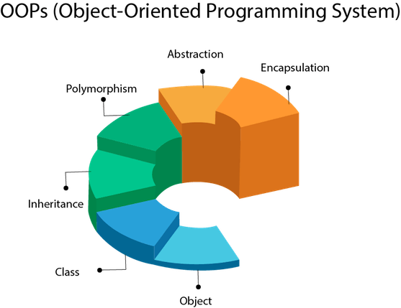

Slide 4
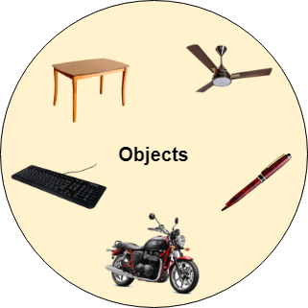
Object
Any entity that has state and behavior is known as an object. For example a chair, pen, table, keyboard, bike, etc. It can be physical or logical.

Slide 5
An Object can be defined as an instance of a class. An object contains an address and takes up some space in memory. Objects can communicate without knowing the details of each other's data or code. The only necessary thing is the type of message accepted and the type of response returned by the objects.

Slide 6
Example: A dog is an object because it has states like color, name, breed, etc. as well as behaviors like wagging the tail, barking, eating, etc.

Slide 7
Class
Collection of objects is called class. It is a logical entity.
A class can also be defined as a blueprint from which you can create an individual object. Class doesn't consume any space.

Slide 8
Inheritance
When one object acquires all the properties and behaviors of a parent object, it is known as inheritance. It provides code reusability. It is used to achieve runtime polymorphism.

Slide 9
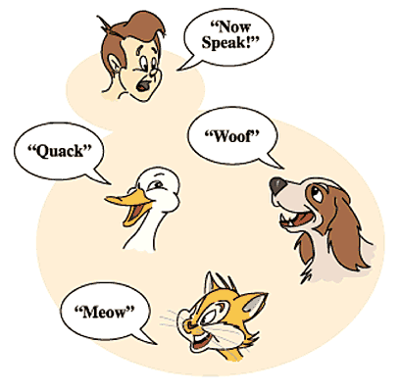
Polymorphism

Slide 10
If one task is performed by different ways, it is known as polymorphism. For example: to convince the customer differently, to draw something, for example, shape, triangle, rectangle, etc.
In Java, we use method overloading and method overriding to achieve polymorphism.
Another example can be to speak something; for example, a cat speaks meow, dog barks woof, etc.

Slide 12
Abstraction
Hiding internal details and showing functionality is known as abstraction. For example phone call, we don't know the internal processing.
In Java, we use abstract class and interface to achieve abstraction.

Slide 13


Slide 14
Encapsulation
Binding (or wrapping) code and data together into a single unit are known as encapsulation.
For example capsule, it is wrapped with different medicines
A java class is the example of encapsulation. Java bean is the fully encapsulated class because all the data members are private here.

Slide 15
Advantage of OOPs over Procedure-oriented programming language
1) OOPs makes development and maintenance easier whereas in a procedure-oriented programming language it is not easy to manage if code grows as project size increases.
2) OOPs provides data hiding whereas in a procedure-oriented programming language a global data can be accessed from anywhere.
3) OOPs provides the ability to simulate real-world event much more effectively. We can provide the solution of real word problem if we are using the Object-Oriented Programming language.

Slide 16
What is the difference between an object-oriented programming language and object-based programming language?
Object-based programming language follows all the features of OOPs except Inheritance. JavaScript and VBScript are examples of object-based programming languages.

